Slide 1


<Name>
<Date>

Slide 2

Outline
Executive Summary
Introduction
Methodology
Results
Conclusion
Appendix

Slide 3
Executive Summary
This project addresses the challenge of optimizing payload pricing for rocket launches, a crucial factor in reducing overall mission costs and enhancing the viability of space missions. By examining SpaceY’s Falcon 9 launch data, we aim to develop a data-driven model that predicts optimal payload pricing while minimizing financial losses associated with launch risks and failures.
Using advanced data science techniques, including machine learning and statistical analysis, our approach analyzes historical launch data to identify patterns that impact launch success and pricing efficiency. Key features such as payload mass, launch location, and mission type are considered to predict the price point at which profitability and success likelihood are maximized.
The outcome of this analysis provides an optimized pricing strategy that aligns with risk mitigation, supporting more cost-effective and reliable space missions. This model has potential applications across the aerospace industry, contributing to more sustainable practices in mission planning and budgeting.

Slide 4
Introduction
In this Data Science project, Space Y aims to determine the optimal launch site for the Falcon 9 rocket to enhance operational efficiency and reduce costs. By analyzing launch data collected from SpaceX's websites, we created a comprehensive dataset, which was meticulously cleaned and preprocessed, including the removal of null values.
Through data exploration and model optimization, we refined key metrics to meet the project's objectives, enabling more informed decision-making for future launches and improved cost-effectiveness for Space Y's Falcon 9 operations.

Slide 5

Section 1

Slide 6
Methodology
Executive Summary
Data collection methodology:
The data is collected from their official website using API and converted it into a dataframe to proceed further.
Perform data wrangling
Removed the null values in the payload and converted the type's of the column from categorical to numerical to train the model
Perform exploratory data analysis (EDA) using visualization and SQL
Perform interactive visual analytics using Folium and Plotly Dash
Perform predictive analysis using classification models
Using various classification algorithms, we build a model to predict the results based on the requirements.

Slide 7
Data Collection
In the following slides, we will see how we collect the data for this project and perform EDA based on the requirements.

Slide 8
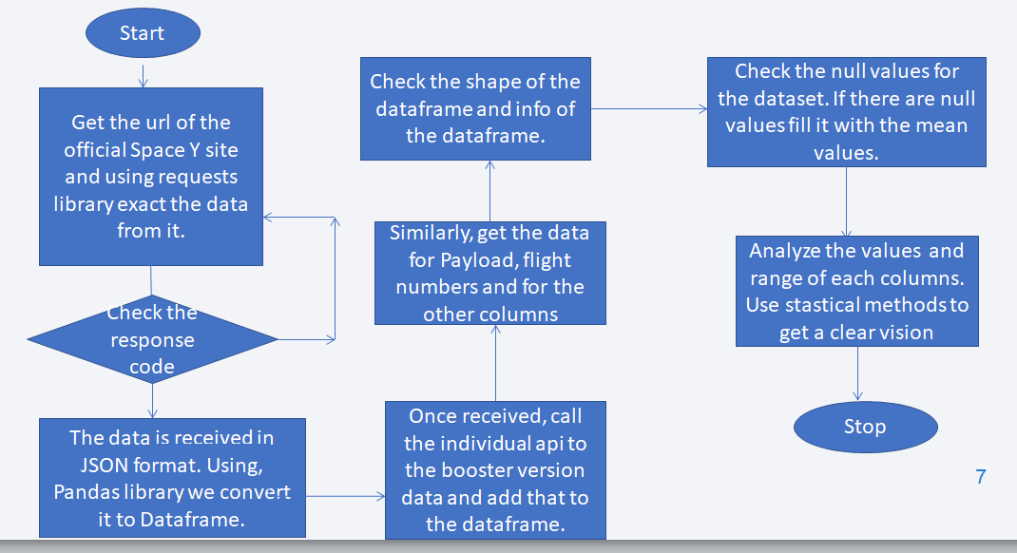
Data Collection – SpaceX API
The data is obtained from the following url,” https://cf-courses-data.s3.us.cloud-object-storage.appdomain.cloud/IBM-DS0321EN-SkillsNetwork/datasets/API_call_spacex_api.json”
The GitHub Url for this section, https://github.com/Aruna2897/IBM_Data_science_course_assignments/blob/main/jupyter_labs_spacex_data_collection_api.ipynb
Place your flowchart of SpaceX API calls here

Slide 9
Data Collection - Scraping
Present your web scraping process using key phrases and flowcharts
Add the GitHub URL of the completed web scraping notebook, as an external reference and peer-review purpose
Place your flowchart of web scraping here

Slide 10
Data Wrangling
Describe how data were processed
You need to present your data wrangling process using key phrases and flowcharts
Add the GitHub URL of your completed data wrangling related notebooks, as an external reference and peer-review purpose

Slide 11
EDA with Data Visualization
Summarize what charts were plotted and why you used those charts
Add the GitHub URL of your completed EDA with data visualization notebook, as an external reference and peer-review purpose

Slide 12
EDA with SQL
Using bullet point format, summarize the SQL queries you performed
Add the GitHub URL of your completed EDA with SQL notebook, as an external reference and peer-review purpose

Slide 13
Build an Interactive Map with Folium
Summarize what map objects such as markers, circles, lines, etc. you created and added to a folium map
Explain why you added those objects
Add the GitHub URL of your completed interactive map with Folium map, as an external reference and peer-review purpose

Slide 14
Build a Dashboard with Plotly Dash
Summarize what plots/graphs and interactions you have added to a dashboard
Explain why you added those plots and interactions
Add the GitHub URL of your completed Plotly Dash lab, as an external reference and peer-review purpose

Slide 15
Predictive Analysis (Classification)
Summarize how you built, evaluated, improved, and found the best performing classification model
You need present your model development process using key phrases and flowchart
Add the GitHub URL of your completed predictive analysis lab, as an external reference and peer-review purpose

Slide 16
Results
Exploratory data analysis results
Interactive analytics demo in screenshots
Predictive analysis results

Slide 17

Section 2

Slide 18
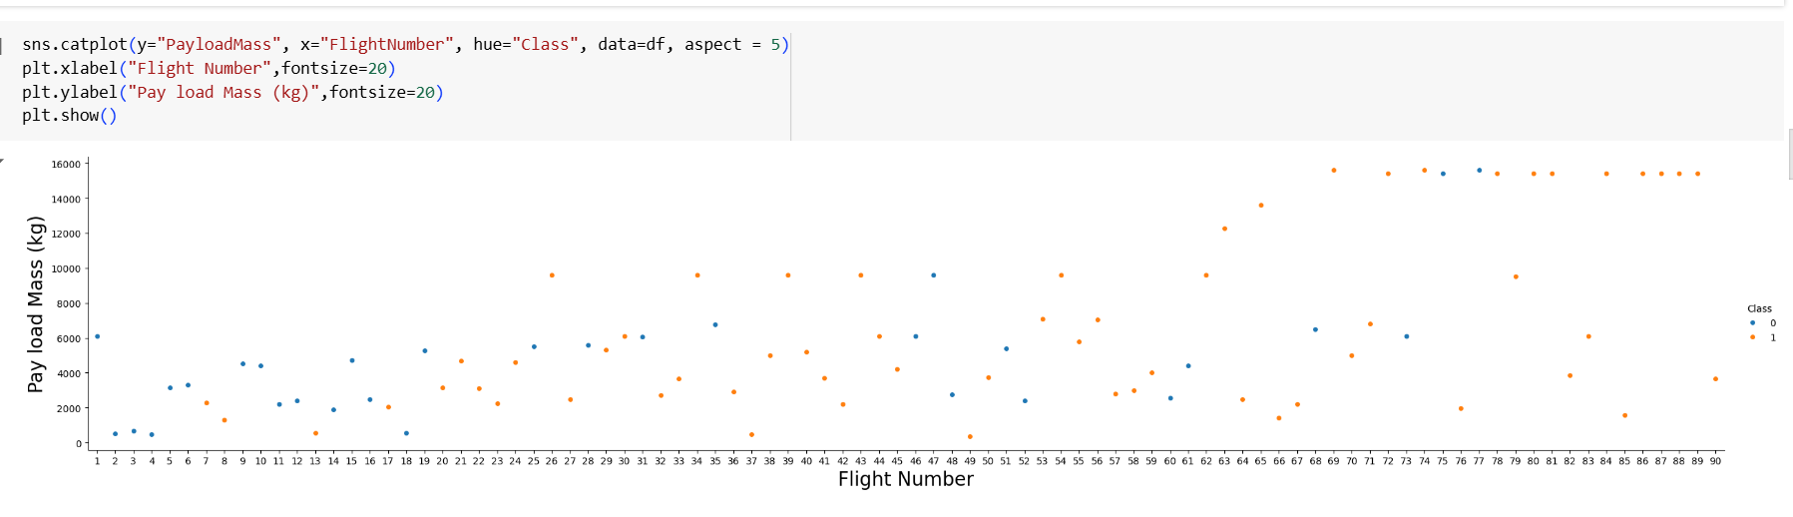
Flight Number vs. PayloadMass
We see that as the flight number increases, the first stage is more likely to land successfully. The payload mass also appears to be a factor; even with more massive payloads, the first stage often returns successfully.

Slide 19
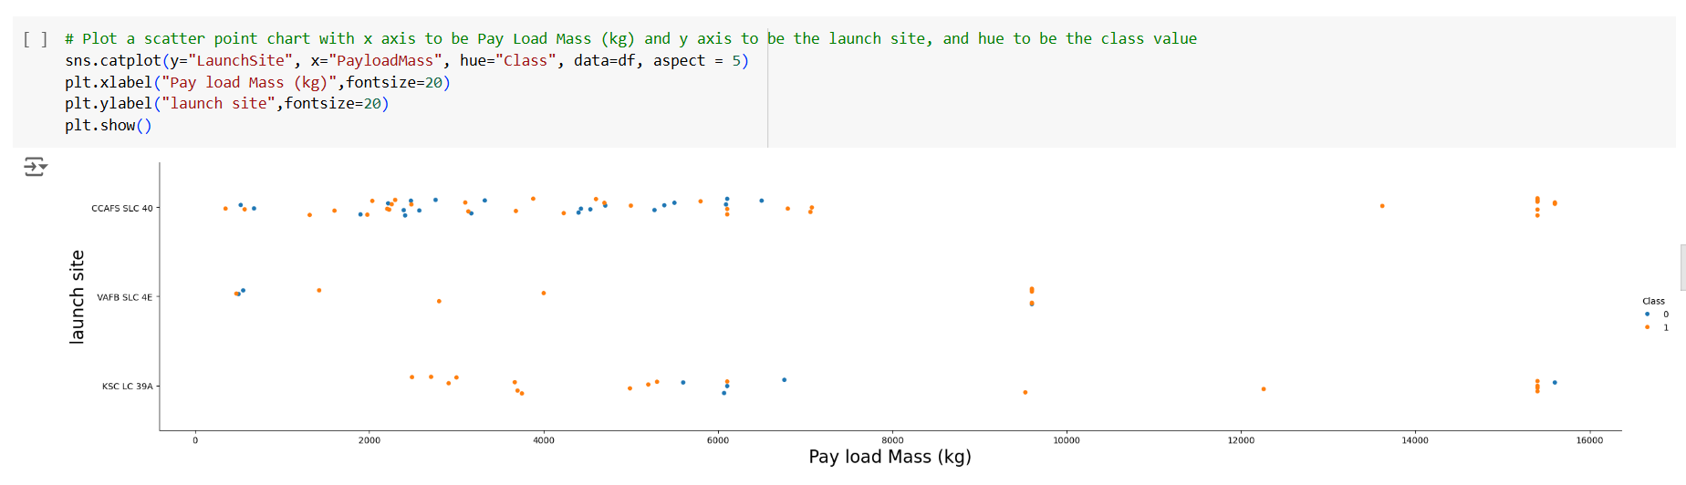
Payload vs. Launch Site
As we can see, The launch site CCAFS SLC 40 has highest number of payloads.

Slide 20
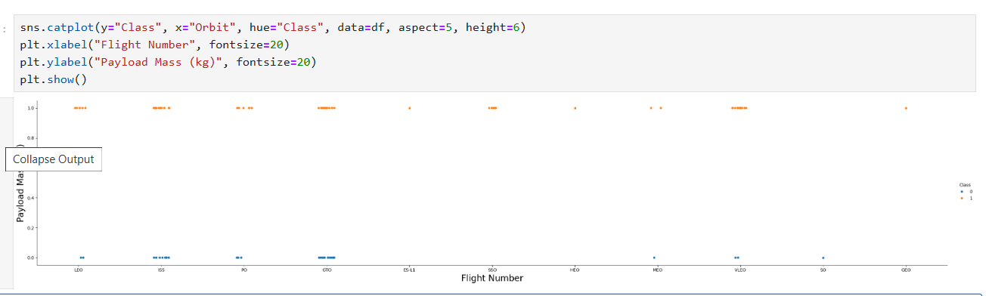
Success Rate vs. Orbit Type

Slide 21
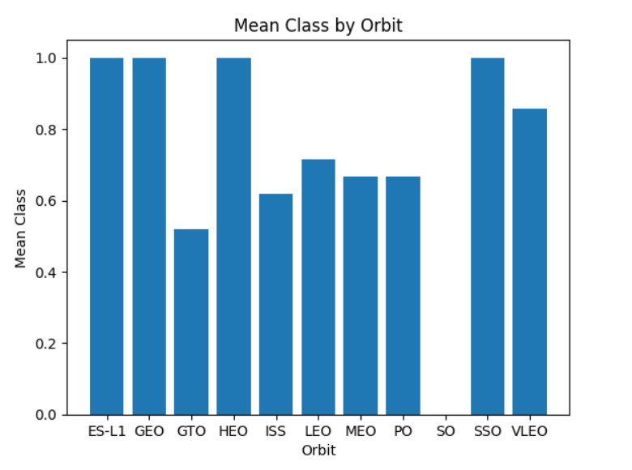
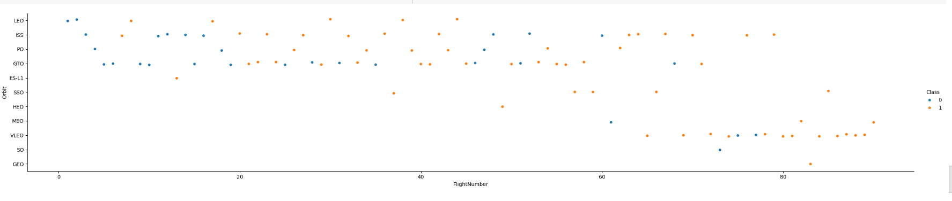
Flight Number vs. Orbit Type

Slide 22
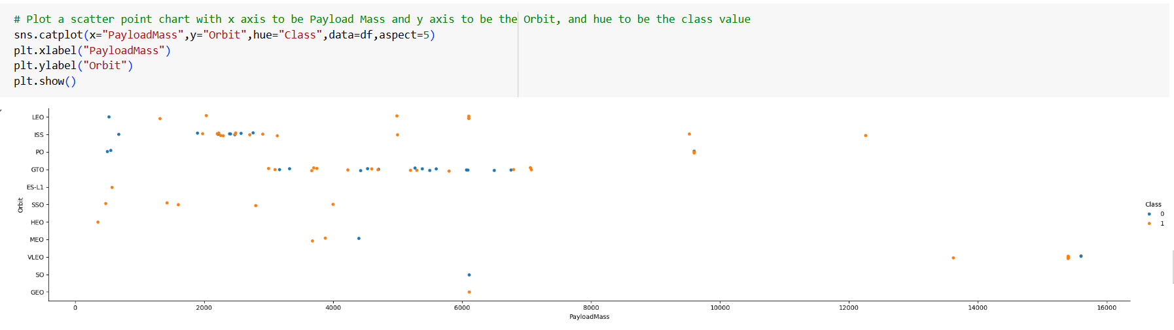
Payload vs. Orbit Type

Slide 23
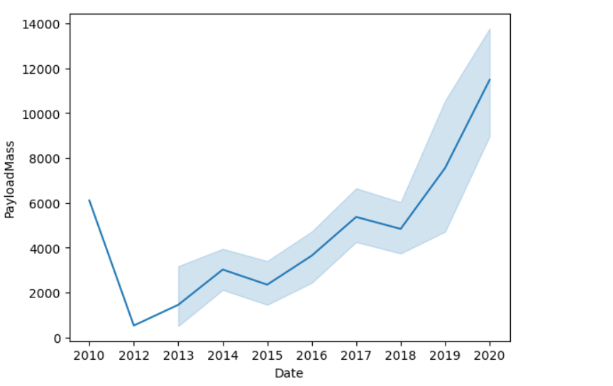
Launch Success Yearly Trend
We can observe that the success rate since 2013 kept increasing till 2020.

Slide 24
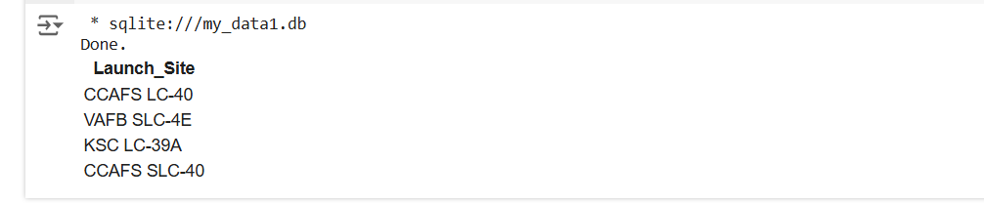
All Launch Site Names
The query to find the names of all launch site is “%sql Select Distinct Launch_Site from SPACEXTABLE;”

Slide 25
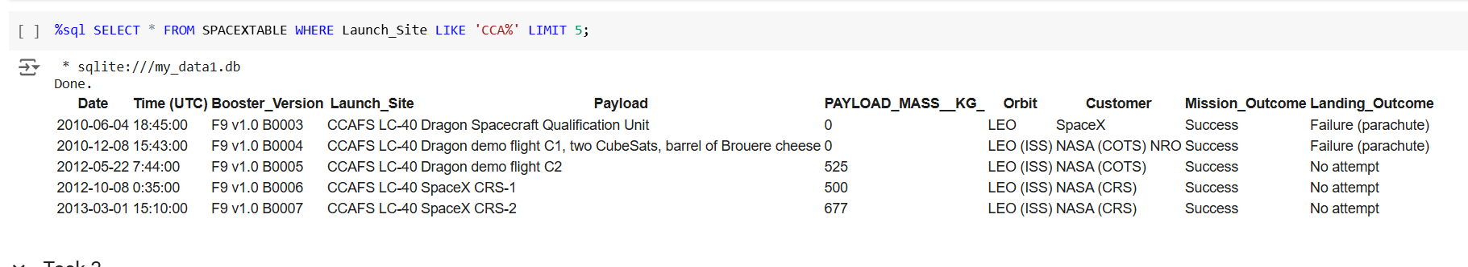
Launch Site Names Begin with 'CCA'
The below image displays the five records where launch sites begin with the string 'CCA'

Slide 26
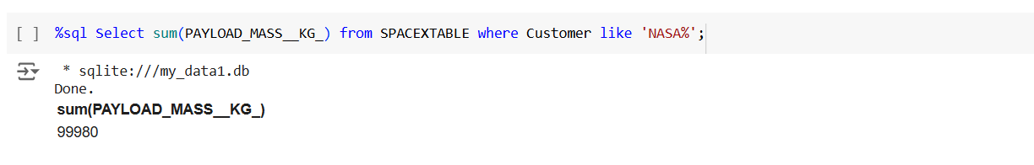
Total Payload Mass
The total payload carried by boosters from NASA is calculated using sum built in function of sql.

Slide 27
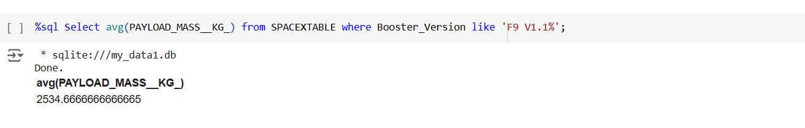
Average Payload Mass by F9 v1.1
The average payload Mass by F9 v1.1 is calculated as below,

Slide 28
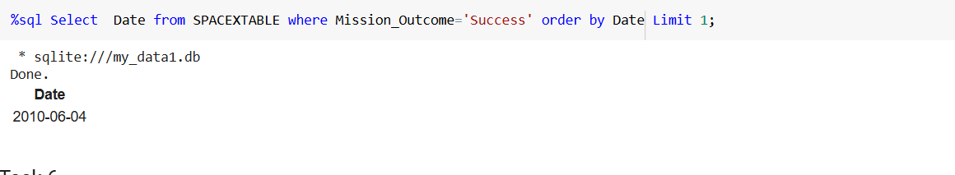
First Successful Ground Landing Date
As we can see, the first successful ground landing date is 2010-06-04.

Slide 29
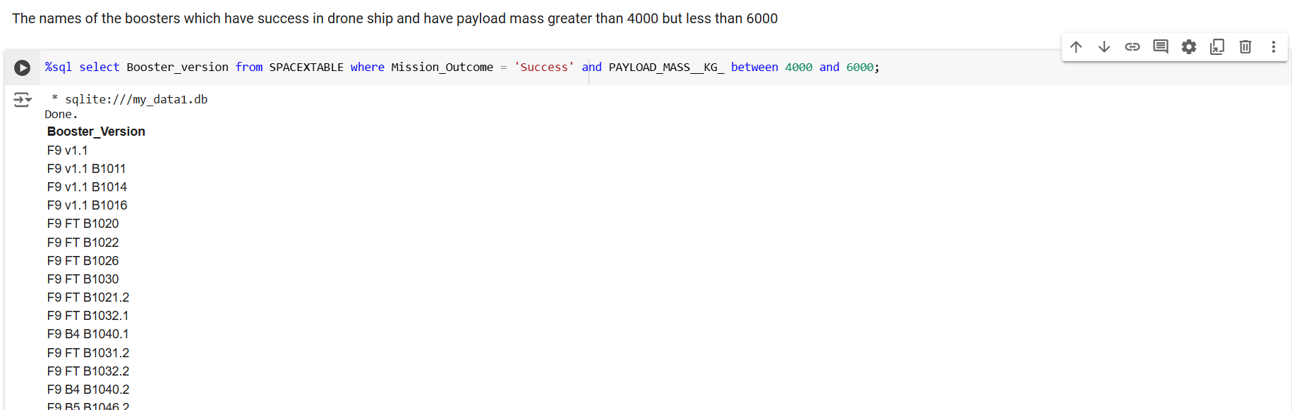
Successful Drone Ship Landing with Payload between 4000 and 6000

Slide 30
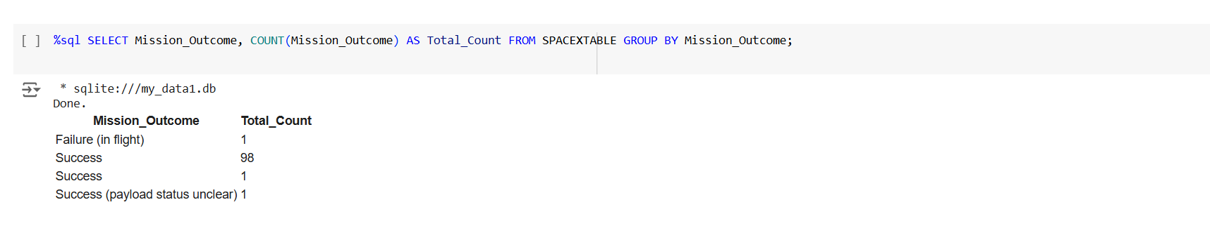
Total Number of Successful and Failure Mission Outcomes

Slide 31
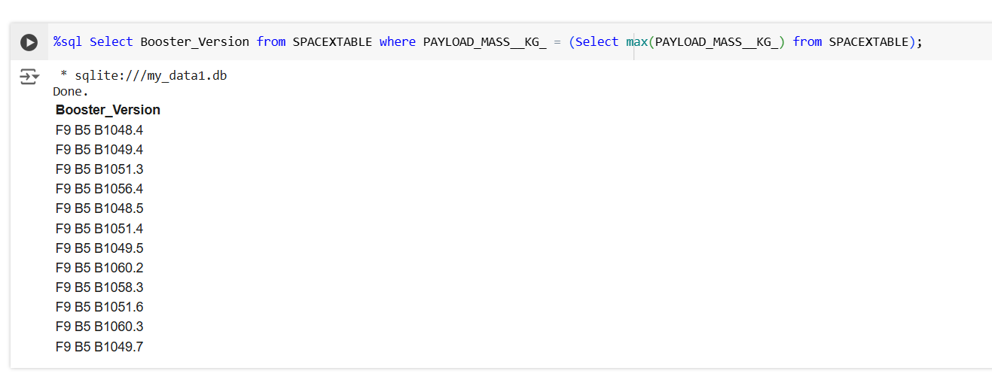
Boosters Carried Maximum Payload
The boosters carried Maximum Payload is obtained by using sub query methods.

Slide 32
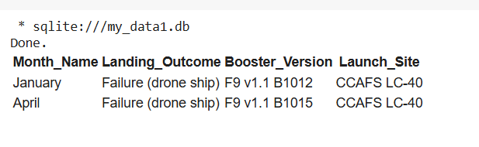
2015 Launch Records
The results of 2015 failed launch records as shown below. The query is in the sql notebook.

Slide 33
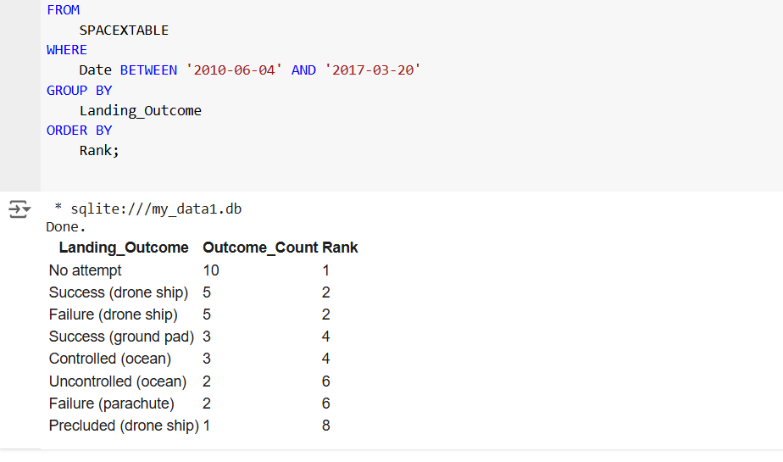
Rank Landing Outcomes Between 2010-06-04 and 2017-03-20
The results of landing Outcomes Between 2010-06-04 and 2017-03-20. The query used for this is %%sql
SELECT
Landing_Outcome,
COUNT(*) AS Outcome_Count,
RANK() OVER (ORDER BY COUNT(*) DESC) AS Rank
FROM
SPACEXTABLE
WHERE
Date BETWEEN '2010-06-04' AND '2017-03-20'
GROUP BY
Landing_Outcome
ORDER BY
Rank;

Slide 34

Section 3

Slide 35
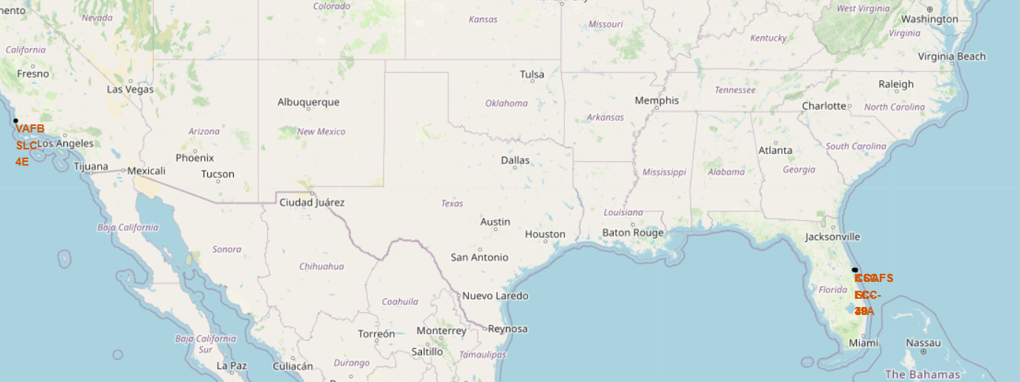
Folium Map to locate the launch sites
This map illustrates the launch sites in various location.

Slide 36
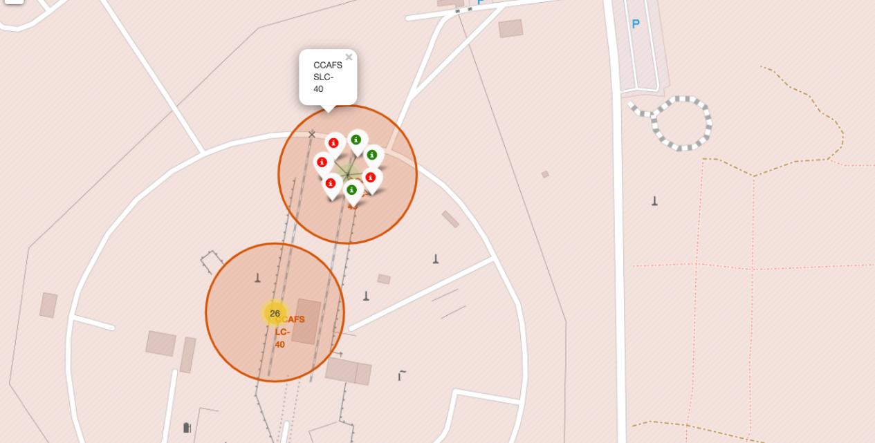
Folium Map to show launch site success Rate
Here, we can see the success and failure launch counts in different colors.

Slide 37
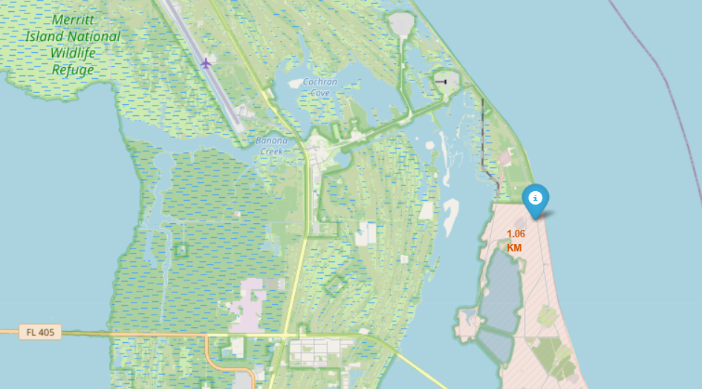
Folium Map to calculate the nearest distance
From this Map, we can infer that the launch site is located Proximity to Transportation Infrastructure and nearer the Equator.

Slide 38

Section 4

Slide 39
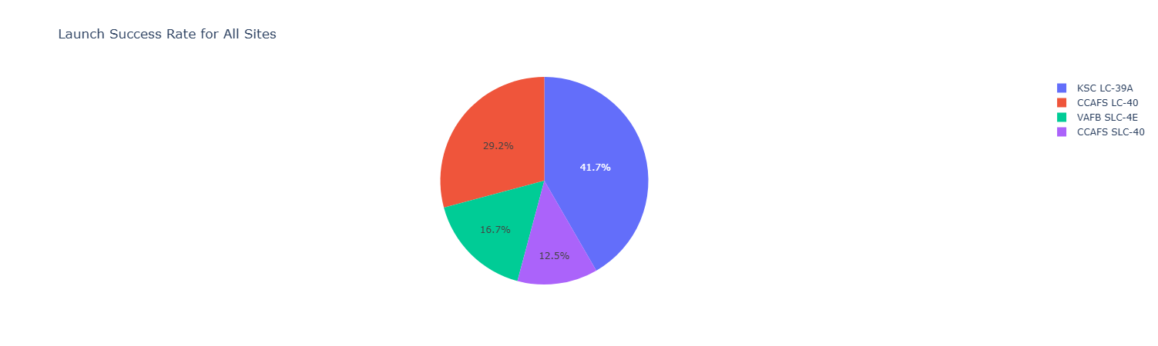
Pie chart of launch success count for all sites
The screenshot of launch success count for all sites, in a pie chart. Here, we can compare which launch site has the highest.

Slide 40

Pie chart of the most successful launch site
The most successful launch site is KSC-LC-39A

Slide 41
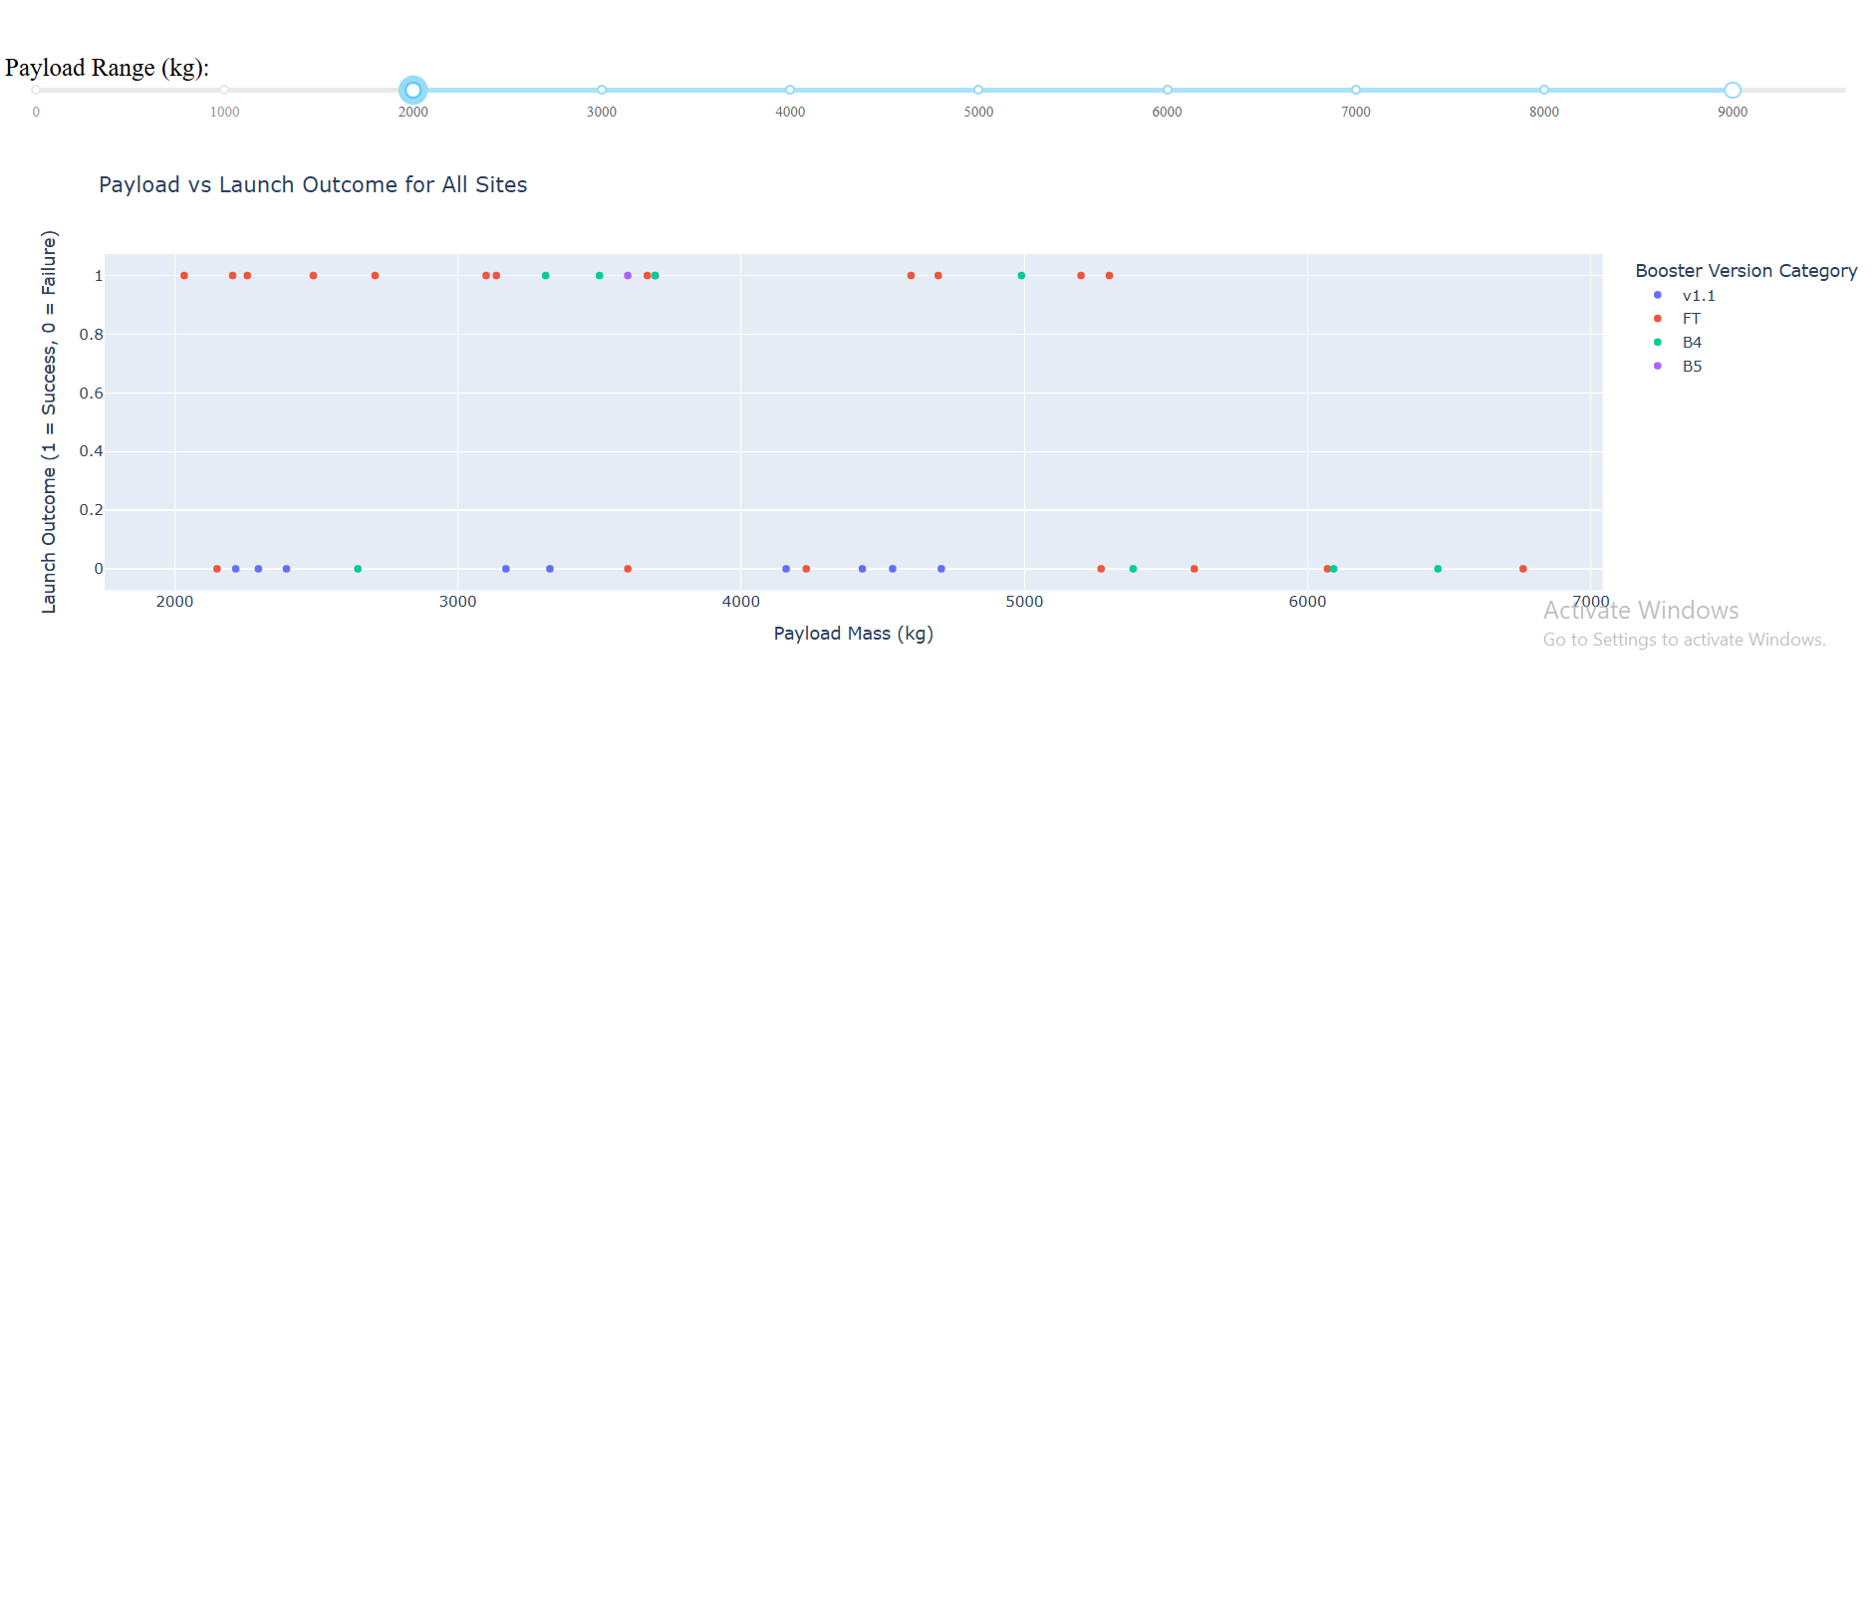
Scatter Plot of Payload vs. Launch Outcome
The importance of the payload and booster version lies in maintaining an optimal weight to transport the satellite to space. As the payload size increases, accommodating it becomes more challenging

Slide 42

Section 5

Slide 43
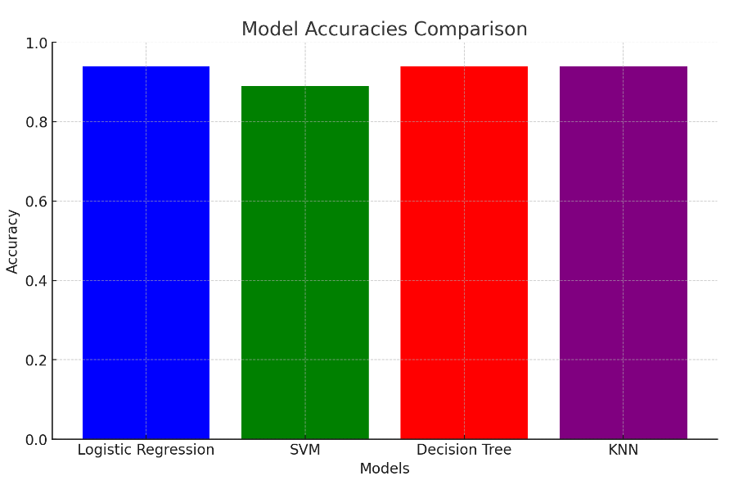
Classification Accuracy

Slide 44
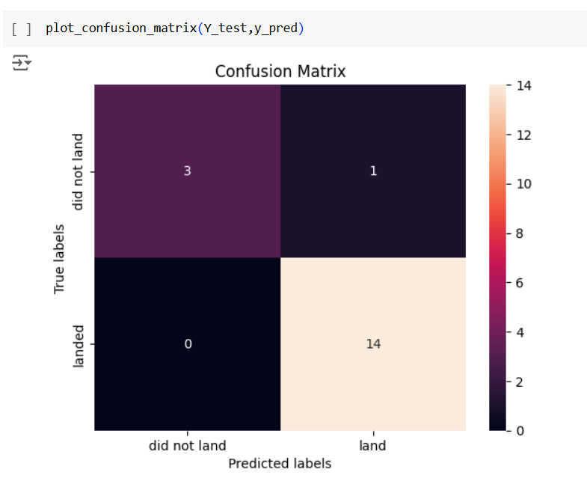
Confusion Matrix
The Confusion Matrix of KNN model is shown as below,

Slide 45
Conclusions
The best model for predicting a successful launch site should incorporate these discussed factors: proximity to reliable transportation infrastructure, coastal equatorial positioning for efficiency and safety, and distance from populated areas.
These factors collectively enhance logistical, operational, and safety outcomes for rocket launches.
In this project, we determined that the best model for predicting the success rate of rocket launches is based on the K-Nearest Neighbors (KNN) classification algorithm

Slide 46
Appendix
https://github.com/Aruna2897/IBM_Data_science_course_assignments
https://github.com/Aruna2897/IBM_Data_science_course_assignments/commit/a386e53069810f912ec99c1542aff617f109c9c8

Slide 47


